Slide 1
Bowerman & Bowman-WF FOUNDING FAMILY
WEDNESDAY, JULY 10, 6:00-9:30
WEST FALMOUTH LIBRARY IN COOPERATION WITH OUR
WEST FALMOUTH FRIENDS (QUAKERS) OF
THE PREPARATORY MEETING
6:00 TALK AND SLIDES OF ARCHIVAL DOCUMENTS
7:00 TOUR OF THE FRIENDS QUAKER MEETING HOUSE
8:00 RECEPTION (FOOD AND DRINK) AT THE LIBRARY AND OPPORTUNITY TO MINGLE AND VIEW ARCHIVE DISPLAYS AND COLLECTIONS
BONUS: THURSDAY 7/11 at 9:00 AM GUIDED WALK TO THE OLD QUAKER CEMETERY AND FIRST MEETING HOUSE SITE
Meet in Library Parking Lot. We will walk up the hill and turn left at Friends Way
.4 miles (10 minutes each way). Easy walk once you get up the hill.
Funded in part with a grant from the institute for museum and library services administered by the Massachusetts board of library commissioners

Slide 2
My sincere thanks goes to: Ben Coffin for the loan of Bowman early 1700s artifacts that he discovered in his house in 2001. The Bowerman and Bowman families for their donation of archival records and photographs. David Young, Abigail Young, Erica Adams and Susan Carliss for assisting with research for this and other presentations. The entire library staff for covering the circulation desk while I chased down facts and scoured the archives finally thank you to Friends (Quakers) of the Preparatory Meeting who have graciously invited you all for a guided tour of the Meeting House at 7:00pm
How important were the Bowermans and Bowmans to the history and heritage of West Falmouth? Two cemeteries give us clues:
The West Falmouth Friends Cemetery: 341 total Memorials…
38 Bowman and 33 Bowerman (62 Swift and 76 Gifford)
The Oak Grove Cemetery: 5,258 Memorials…
66 Bowman and 1 Bowerman (117 Swift and 81 Gifford)
Totals for both cemeteries:
179 Swift
157 Gifford
104 Bowman
34 Bowerman

Slide 3
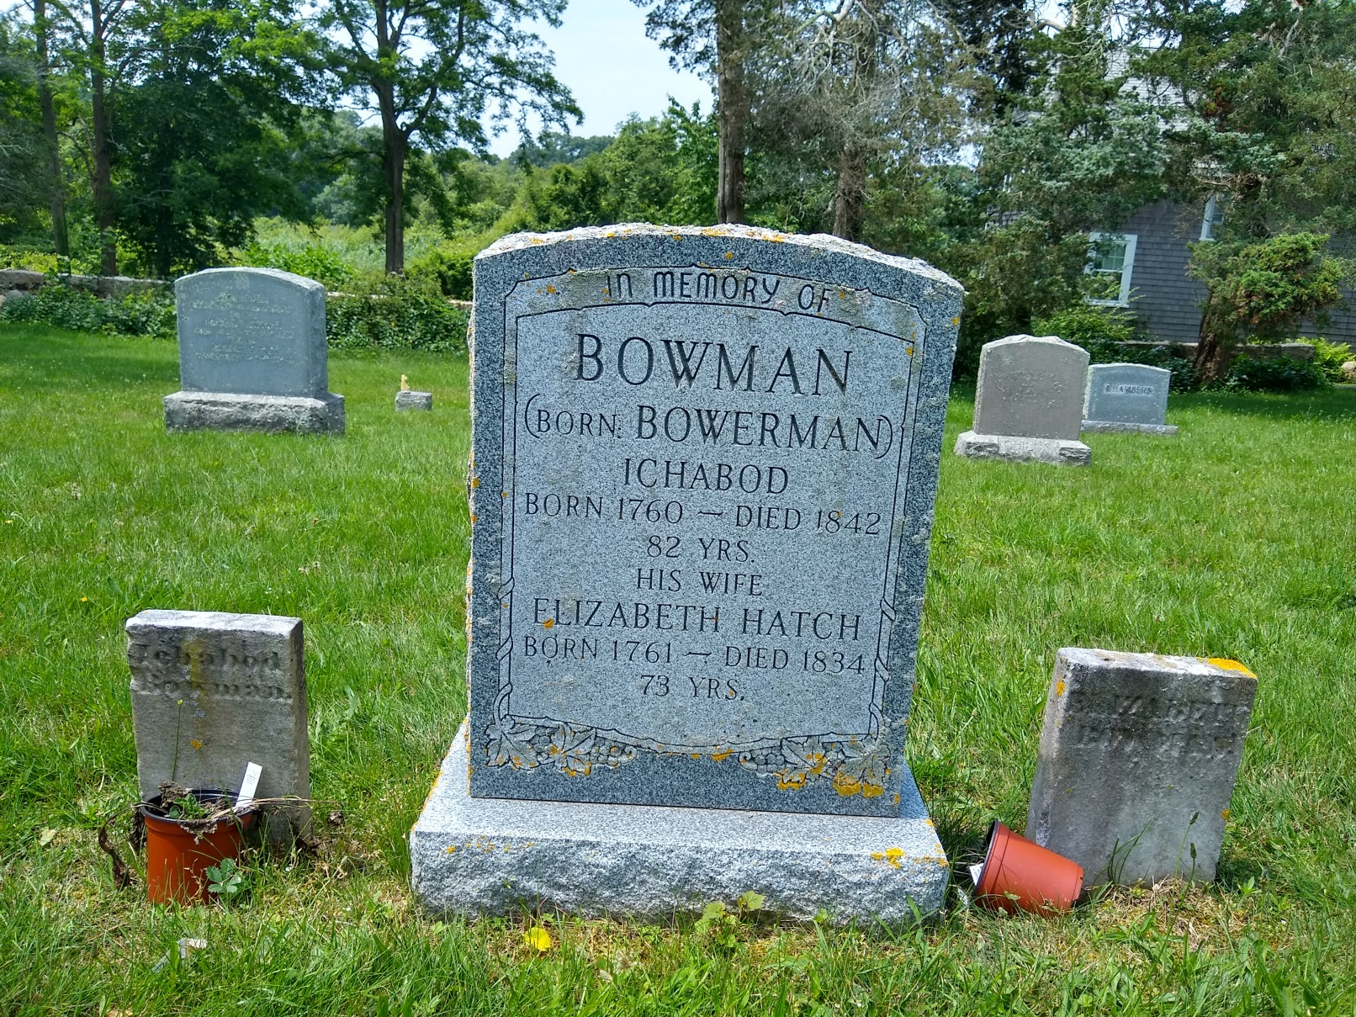
Where to start?

Slide 4
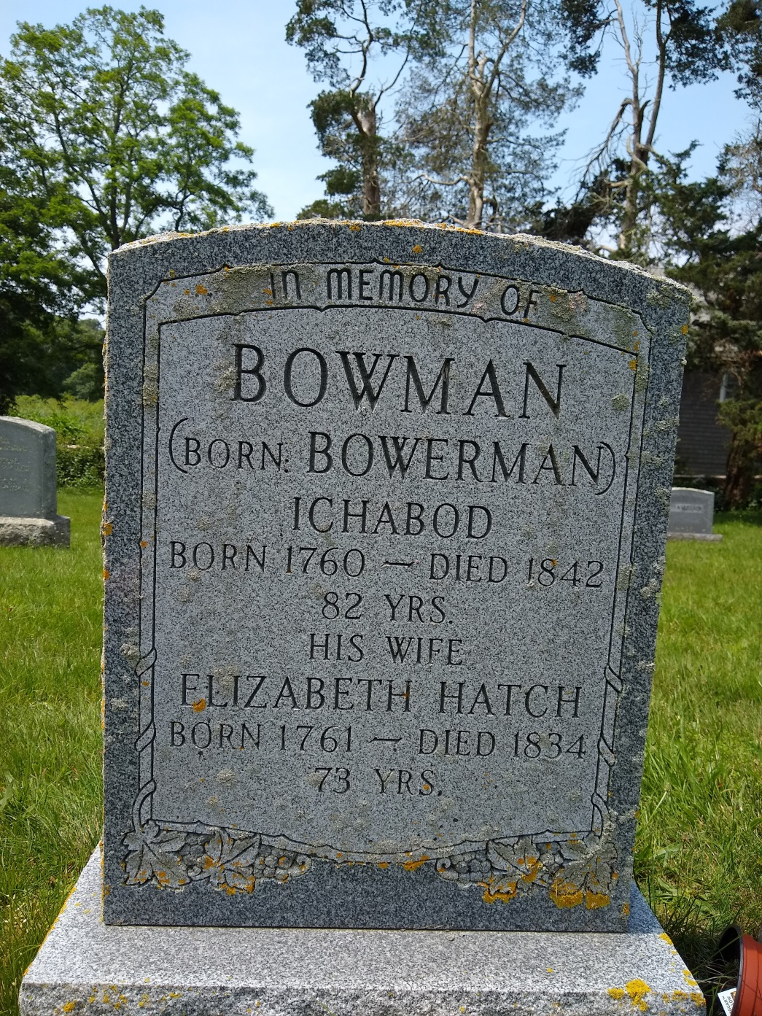

Slide 5
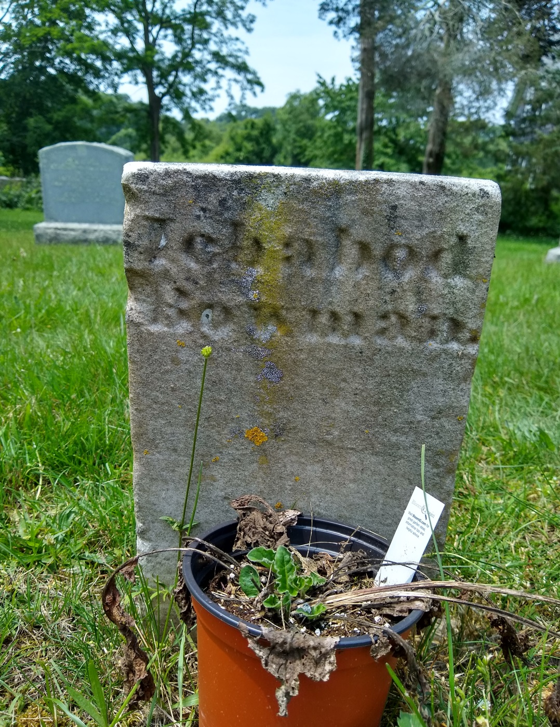

Slide 6
Bowerman & Bowman
The name was recorded as: Bowerman, Bourman, Burman and Boreman. Some descendants recorded it as Bowman; others as Bowerman.
“Thomas Bourman was of Barnstable in 1643. He resided on a farm in West Barnstable at the head of Bridge Creek. Town records show his holdings as: 25 acres of upland, an additional 5 acres of upland and 16 acres of marsh more or less. He was a surveyor of highways in 1648 and a grand juror in 1650. He sold this land in 1662, but also was a proprietor of lands in Suckanesset (Falmouth) during this time. Thomas Bourman died in 1663”.
Otis, Amos, 1801-1875, and Charles Francis Swift. Genealogical Notes of Barnstable Families. Barnstable, Mass.: F. B. & F. P. Goss, 1888-90.

Slide 7
Marriage
Thomas Bourman married Hannah Annabelle in 1644.
The ancestry of the West Falmouth Bowermans and Bowmans begins here. Thomas and Hannah had seven children:
Hannah May 1646
Thomas Sept. 1648
Samuel July 1651 (Slain at Rehobeth March 26, 1676)*.
Desire 1654
Mary 1656
Mehitable 1658
Tristram 1661
“On June 30, 1675, King Phillip (Metacomet-Wampanoag Chief and son of Massasoit) led a small force in a surprise attack against an undefended Rehoboth settlement, killing settlers, burning houses, and causing residents to live in constant fear of more attacks.”
Otis, Amos, 1801-1875, and Charles Francis Swift. Genealogical Notes of Barnstable Families. Barnstable, Mass.: F. B. & F. P. Goss, 1888-90.

Slide 8
Samuel boreman bowman (1651-1676: Age 25)
“The Indians of the Cape remained neutral during King Phillip’s War and were considered a defense to Sandwich and the towns below. In 1676 one reverse at Rehoboth, early in the war, cost the Cape twenty men— Barnstable six, Yarmouth and Sandwich five each, and Eastham four. The almost entire command of Captain Pierce of Scituate — fifty men and twenty Indians — was massacred, including the captain himself. The names of the Barnstable men lost were: Samuel Child, Lieutenant Fuller, John Lewis, Eleazur Cobb, Samuel Linnet and Samuel Boreman or Bowman. We are unable to find the list from the other towns. The Indians lost were Cape Indians, and only one was permitted to return”.
Otis, Amos, 1801-1875, and Charles Francis Swift. Genealogical Notes of Barnstable Families. Barnstable, Mass.: F. B. & F. P. Goss, 1888-90.

Slide 9
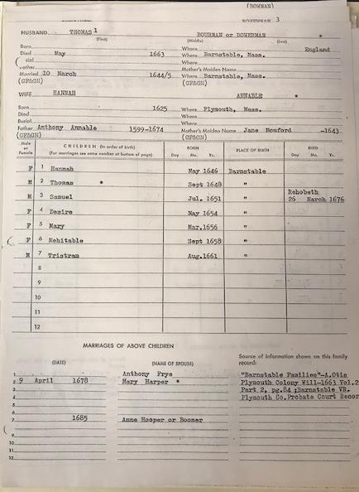
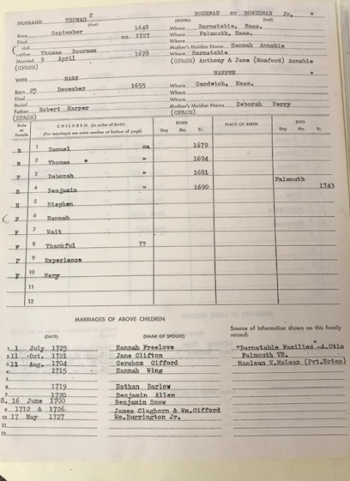

Slide 10
West falmouth (BOURMAN-BOWERMAN)
Thomas Bourman was granted lands in Sucannessett (Falmouth (Saconesset Hills) in 1661. Thomas Bowerman (son) is mentioned as a neighbor of William Gifford in a document dated 1668 which says: “and also that Thomas Bowerman shall without damage to him dry his fodder on said Island and to dry his fodder ye point of upland with ye said William Gifford’s field next adjoining his house”.
Thomas (the son) married Mary Harper, daughter of Robert Harper in 1678. The Bowerman Homestead is thought to have been built in 1688. Thomas (the son) deeded the house and land to his son Benjamin in 1727.
The Homestead remained occupied by a Bowerman descendant until 1963.

Slide 11
BOURMAN TO BOWERMAN (3 BROTHERS)
“Thomas Bourman (son of the second Thomas) resided on an estate owned by Captain Nathaniel Eldredge. He married Jane Hardy and had children: Ichabod, Judah who married Mary Dillingham 1758, David married Ruth Dillingham 1751 and Hannah Wing 1770, Silas married second Lydia Gifford, Joseph married Rest Swift 1766, Sarah married Melatiah Gifford 1773, Jane married Joseph Bowman, Elizabeth, Peace who did not marry, and Deborah”.
“Benjamin wrote his name Bowerman
as many in the family now do”
“Samuel married three wives: first 1743 Rose Landers, second 1746 Jemimah Wing, third 1785 Grace Hoxie”.
Otis, Amos, 1801-1875, and Charles Francis Swift. Genealogical Notes of Barnstable Families. Barnstable, Mass.: F. B. & F. P. Goss, 1888-90.

Slide 12
BOWERMAN OR BOWMAN (ONE FAMILY TWO SURNAMES)?
Religion? Quaker (practicing or not) (supporting or not)
Superstition? (bad luck in occupation, family)
Family choice?
A theory? Rachel Bowerman (1769-1864) married
Abraham Hoxie. Her daughter Hannah (d. 1835) married Savory Bowman (1798-1874).
The 1850 and 1860 censuses show Rachel Bowerman Hoxie (then over 80 and 90, respectively-living in Savory Bowman’s house (which was generous of him, since Savory remarried after Hannah’s death),
Hannah Bowman (Savory’s wife and Daughter of Rachel Bowerman) gave birth to Benjamin Bowman (1828-1873) for who findagrave.com shows no descendants.
and…there is this:

Slide 13
Then, we have Ichabod Bowman (nee Bowerman)
(1760-1842) who had only one child, a daughter born in 1801. That daughter, used Bowerman as her maiden name.
Is Ichabod Rachel’s brother? (find a grave does not list Ichabod’s parents).
Is it possible that Savory Bowman took in both Ichabod and Rachel, beginning after the 1840 census and before Ichabod death, and Ichabod (out of gratitude, altered his name. No one would care how Rachel spelled out the B. in Rachel B. Hoxie.
What do you know or what have you heard?

Slide 14
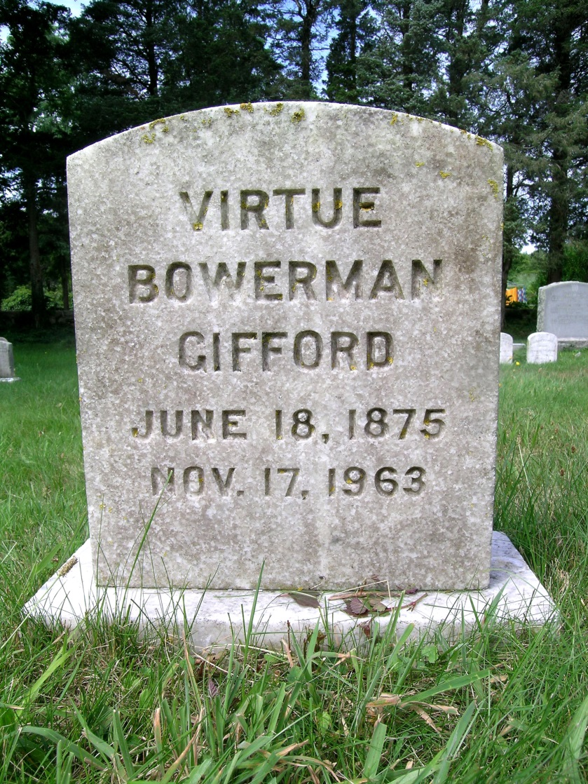
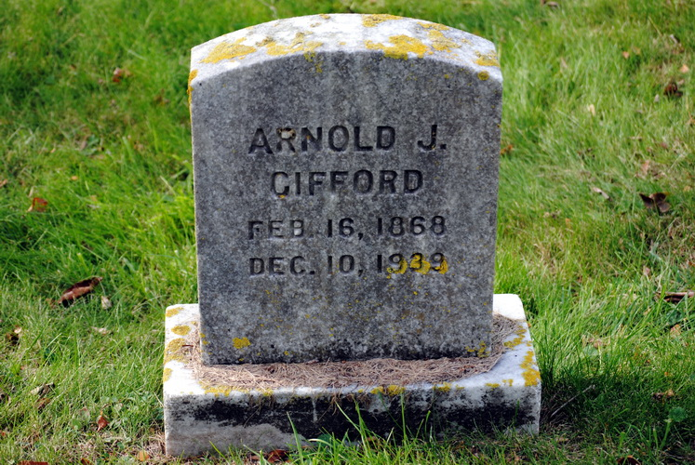
Virtue russell Bowerman gifford
Virtue was 7 years younger than Arnold. She outlived him by 24 years. Arnold died in 1939 at age 71. Virtue died in 1963 at age 88.

Slide 15
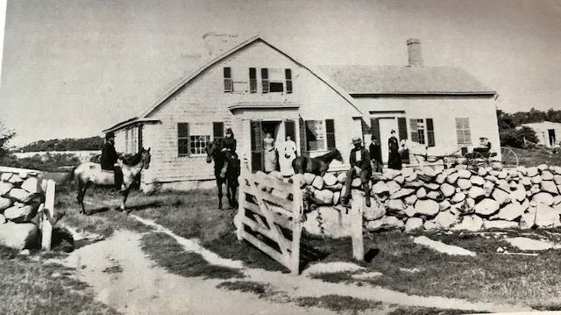

Slide 16
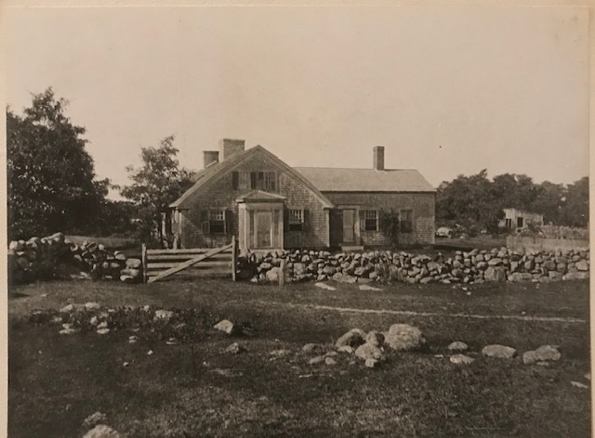

Slide 17
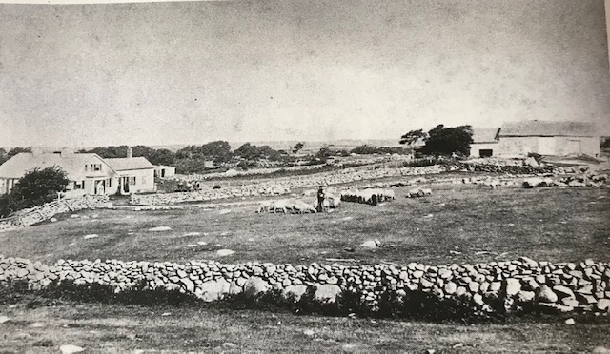
By 1831 Falmouth was the leading sheep raising town in the county with 2,974 animals; most of those in West Falmouth.

Slide 18
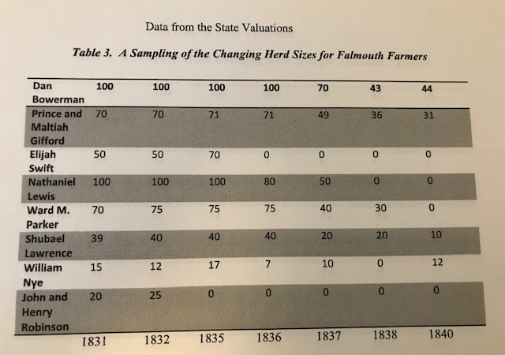
Prior to 1830 there was a market for small sheep farmers. After 1830, mills chose to look to Naushon Island for wool, as it was easier to contract with one herd of 1,000 sheep, than it was to do business with multiple small farmers.
Sheep and Wool in Nineteenth-Century Falmouth, MA: Examining the Collapse of a Cape Cod Industry
Leo Patrick Ledwell University of Massachusetts Boston

Slide 19
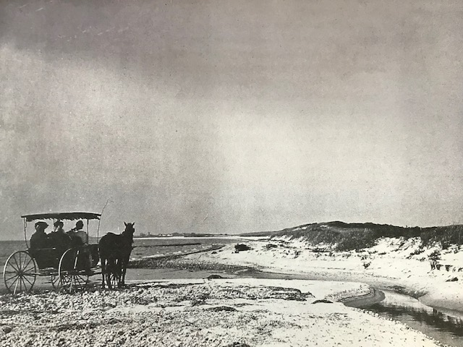
By the mid 1800s, it was difficult for farm families to support families on land that had been subdivided multiple times. Whaling was also on the decline and seafaring males returned to the village to try to find a new vocation. Some did and stayed; others did not, and left for lands further west.

Slide 20
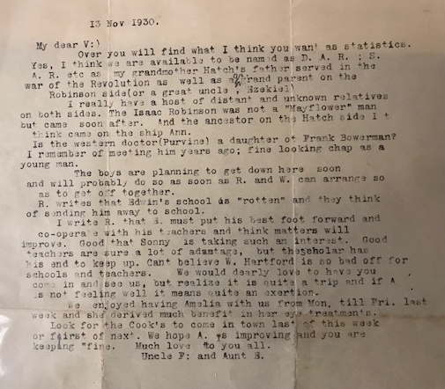

Slide 21
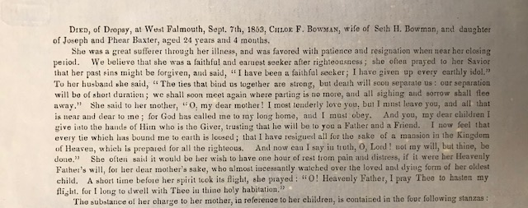
WEST FALMOUTH (BOWMAN)
DIED, of Dropsy, at West Falmouth, Sept. 7th, 1863, Chloe F. Bowman, wife of Seth II Bowman, and daughter of Joseph and Phear Baxter, aged 24 years and 4 months...

Slide 22
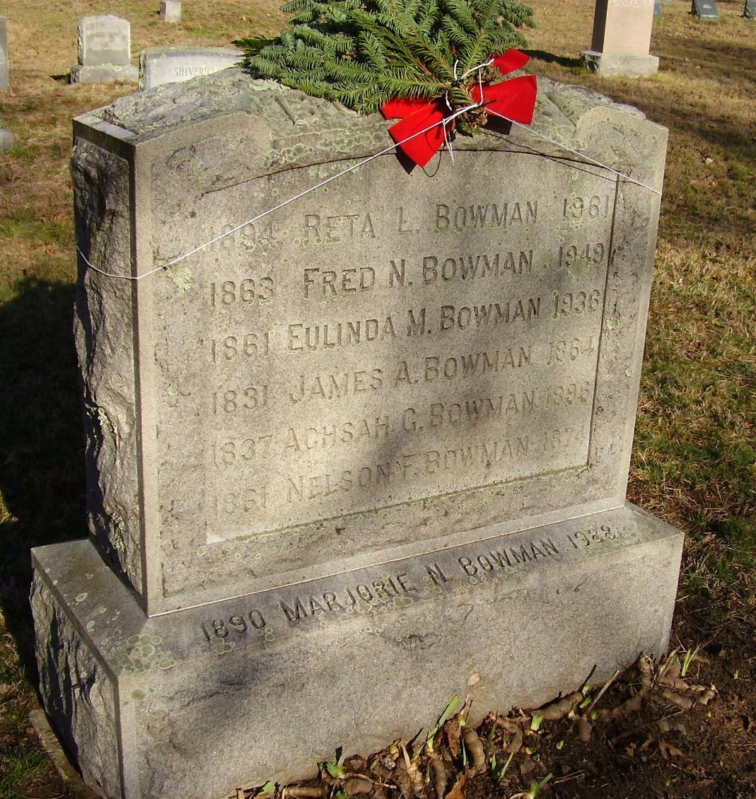
THE BOWMANS-FRED BOWMAN
Son of James Andrew and Achsah Landers Bowman. Born in 1863. He married Eulinda Baker in West Falmouth in 1936. Fred Bowman was a contractor and built a hundred or more homes in the Falmouth area and Martha's Vineyard, including: The West Falmouth Library, The Methodist Church (current) and the Swift residences across the street from the Library??? Children; Grover Bowman; Marjoire N, Hazel M. Nickerson, Rita L. Bowman, Mrs. Lester A. Bourne and Ruth E. Simpson.
findagrave.com

Slide 23
THE BOWMANS
Fred Bowman-Builder (The Library and current Methodist Church ? Swift residences across the street?)
Grover Bowman-Carpenter
Reuben Bowman-Carpenter
Stephen E. Bowman-Carpenter (Bowman collection in archival case)
H. M. Bowman-Painter and Paper Hanger
J.E. Bowman-House painter
Ebenezer Bowman-Seafarer
David H. Bowman-Sea captain
George L. Bowman-Sea captain
Joseph H. Bowman-Sea captain
Zebulon Bowman-Salt manufacturing

Slide 24
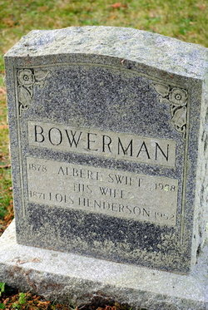
ALBERT SWIFT BOWERMAN
Albert Swift Bowerman was the original owner of the Bowerman Bath House on Bowerman’s Beach. The bath house was rebuilt on large scale after major damage in both the 1938 and 1954 hurricanes. For 40 years, until he resigned in 1939, Mr. Bowerman served as librarian of the West Falmouth library. “During the 40 years Mr. Bowerman missed only one season as librarian”. He also served on the Library Board of Directors. He was a member of the Society of Friends and of the Sandwich Monthly meeting, and he was an alumnus of Moses Brown school.
Albert was the father of Mrs. Frederick C. (Cecelia) Fuglister of Woods Hole who wrote extensively about the history of
West Falmouth, Falmouth, and Woods Hole.
findagrave.com

Slide 25
The bowermans
Albert Swift Bowerman-Librarian West Falmouth Library
Thomas Bowerman Jr.-Farmer, Selectman
Daniel Bowerman-Farmer, Salt manufacturing
Stephen Bowerman-Farmer, Selectman
Barnabus Bowerman-Selectman (12 years)
Joseph Bowerman-Investor, tanner, farmer
Prince Gifford Bowerman-Farmer, builder
Samuel Bowerman-Lawyer
Daniel Bowerman (2nd)-Farmer, miner, carpenter

Slide 26
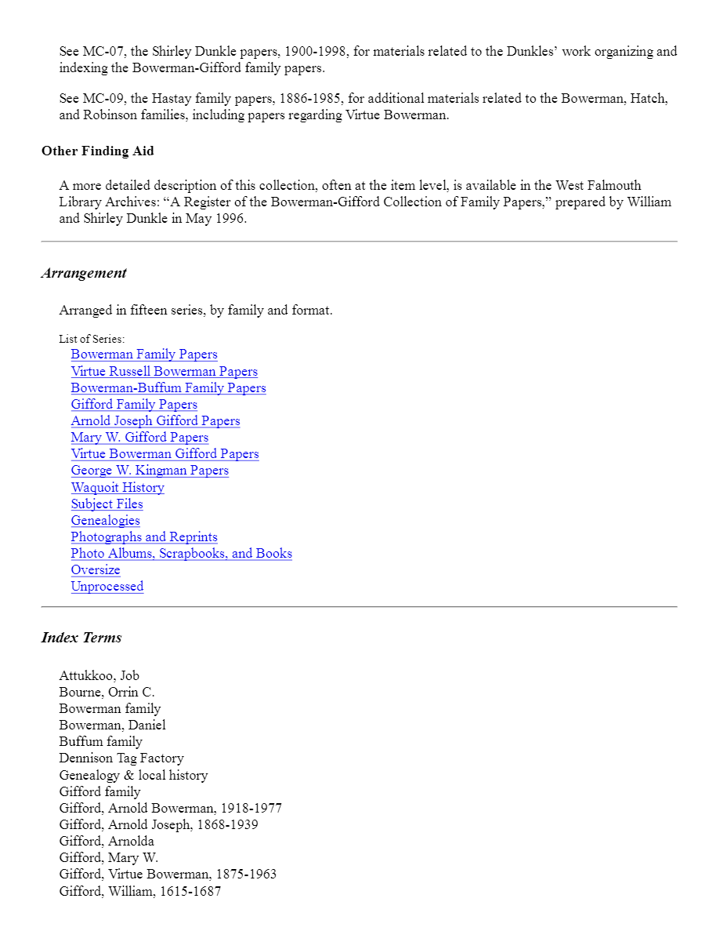
WEST FALMOUTH HISTORY AND HERITAGE A TWO YEAR CELEBRATION
http://www.westfalmouthlibrary.org
HIGHLIGHTS OF THE BOWERMAN/BOWMAN ARCHIVES:

Slide 27
QUESTIONS? COMMENTS!

